Slide 2
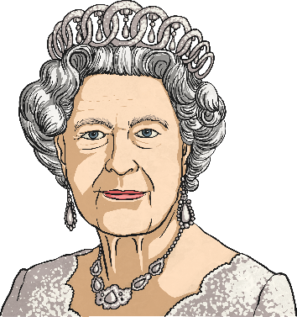

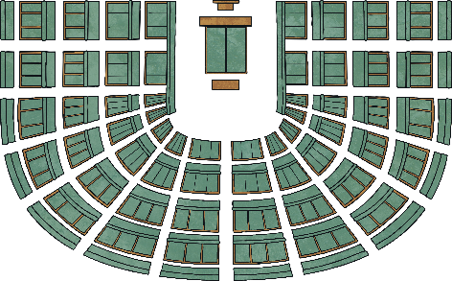
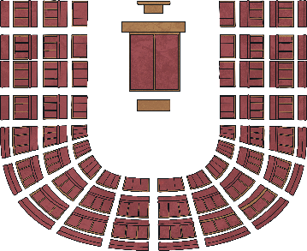
Who Makes up the Australian Federal Parliament?
The Federal Parliament is made up of three institutions.
The Queen is represented in Australia by the Governor-General. The current Governor-General is His Excellency General the Honourable the Honourable David Hurley AC DSC (Distinguished Service Cross).
The House of Representatives
150 Members
The Senate
75 Members
The Queen, the Senate and the House of Representatives together make up the Australian Federal Parliament.
The Senate and the House of Representatives meet in Parliament House, Canberra. The Governor-General lives at Government House in Canberra.

Slide 3


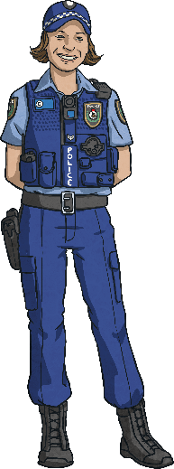



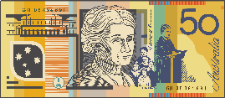

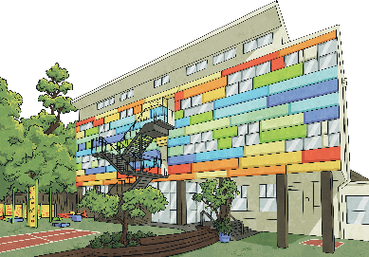
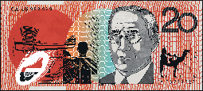

Three Levels of Lawmaking
The Federal Government is one of the three levels of lawmaking in Australia.
The Federal Government makes decisions that affect the commonwealth of Australia like immigration, defence and money matters.
Local councils govern and make laws about building development, rubbish collection and libraries.
The State Government governs and passes laws on state issues like health, education and the environment.

Slide 4
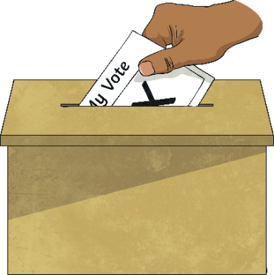
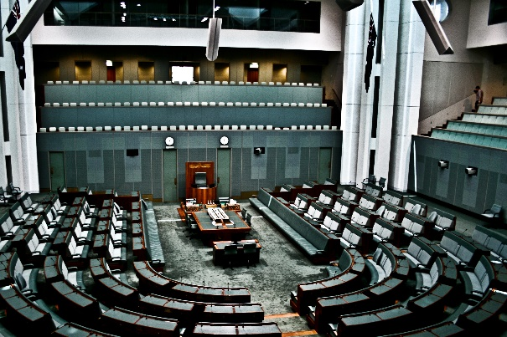
The House of Representatives
The House of Representatives is made up of 150 members who represent the 150 electorates of Australia.
A federal election takes place every three years. People over the age of 18 are required to vote for their preferred candidate. There are approximately 100,000 voters over the age of 18 in each electorate.
A member’s role is to understand the concerns of the people in their electorate. They represent their electorate in the House of Representatives in Parliament House, Canberra.
Did You Know…?
The green colour used for the House of Representatives is based on the seats in the House of Commons in Great Britain. However, it has been changed to more of a grey-green colour to reflect Australia’s native plants, such as eucalyptus.
“The Arena” by Melody Ayres-Griffiths is licensed under CC BY 2.0

Slide 5
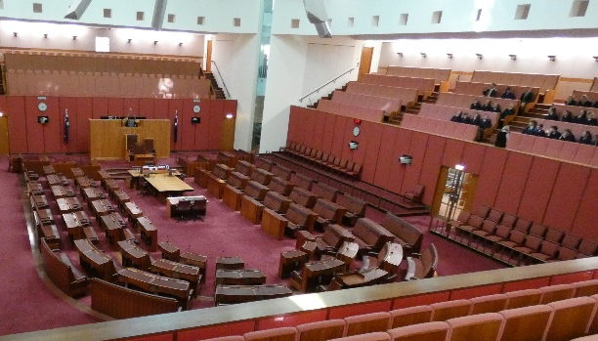
The Senate
The Senate is made up of 76 senators. There are 12 senators in each state and 2 senators for each territory. In federal elections, people over the age of 18 are required to vote for their preferred candidate to represent their state or territory.
A senator’s role is to understand the concerns of the people living in their state or territory. They represent their state or territory in the Senate in Parliament House, Canberra.
Senators serve a six-year term. At every federal election, half the state senators and all of the territory senators need to stand for re-election.
Did You Know…?
The red colour used for the Senate is also based on the House of Lords in Great Britain. What part of the Australian landscape do you think the red colour represents?
“The Senate chambers” by lns1122 is licensed under CC BY 2.0

Slide 6
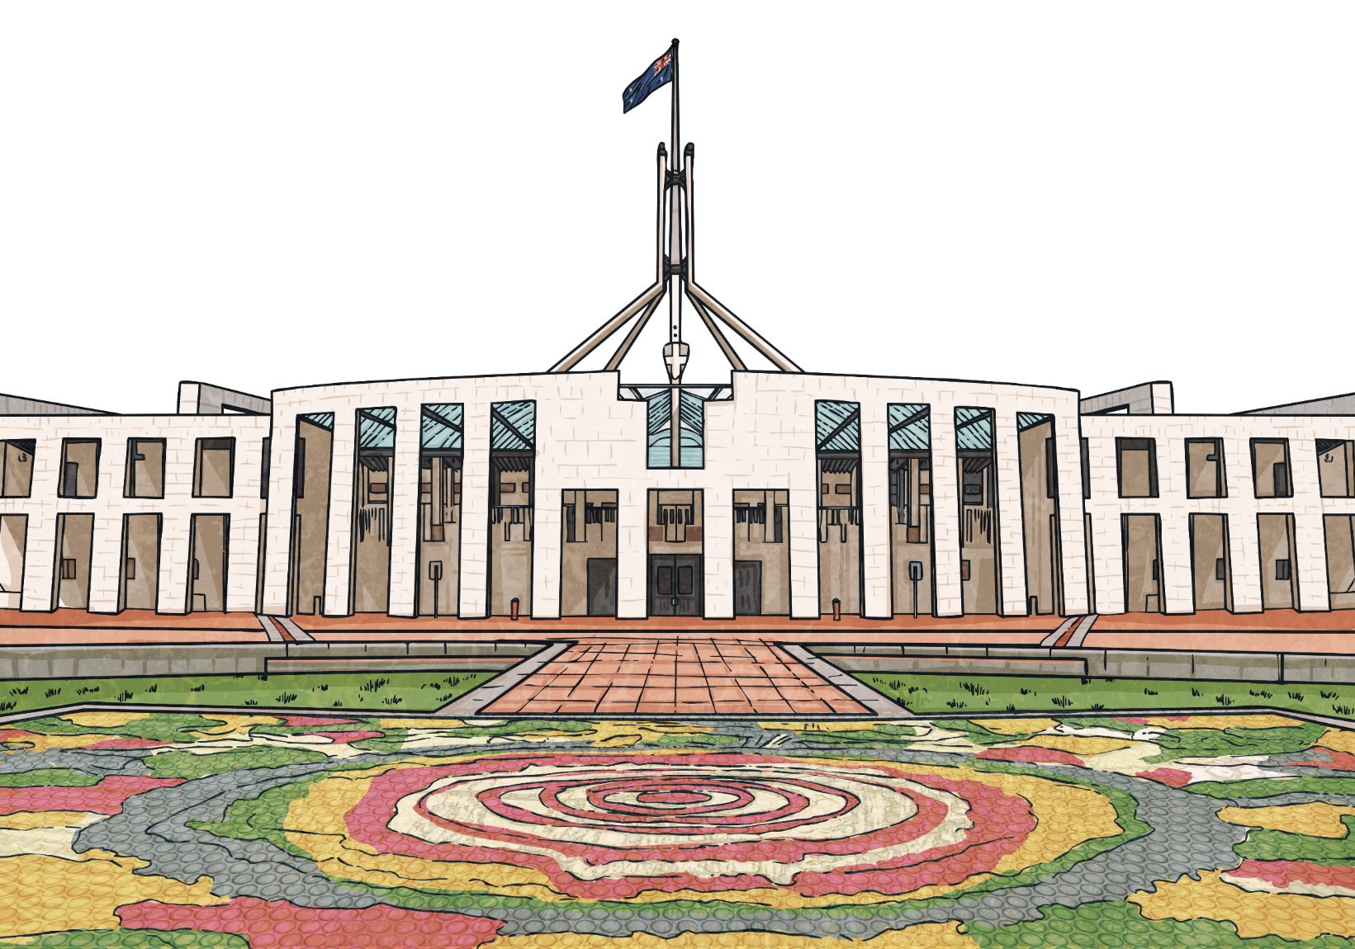
How Is the Federal Government Formed?
Once the federal election has taken place, the party that has secured the majority support forms the government.
The leader of the winning party becomes the Prime Minister. The Prime Minister chooses members from the House of Representatives and senators from the Senate to form the cabinet. They become ministers and have a specific responsibility, such as defence, education and health. Together, the Prime Minister and cabinet govern Australia.
The opposition is the party that secured the second-highest number of votes. Together with the minor parties and independents, they continue to play a part in the running of the country.

